Slide 2

Fundamentals of Reinforcement Learning
WEEK 1

Slide 3

Title

Slide 4
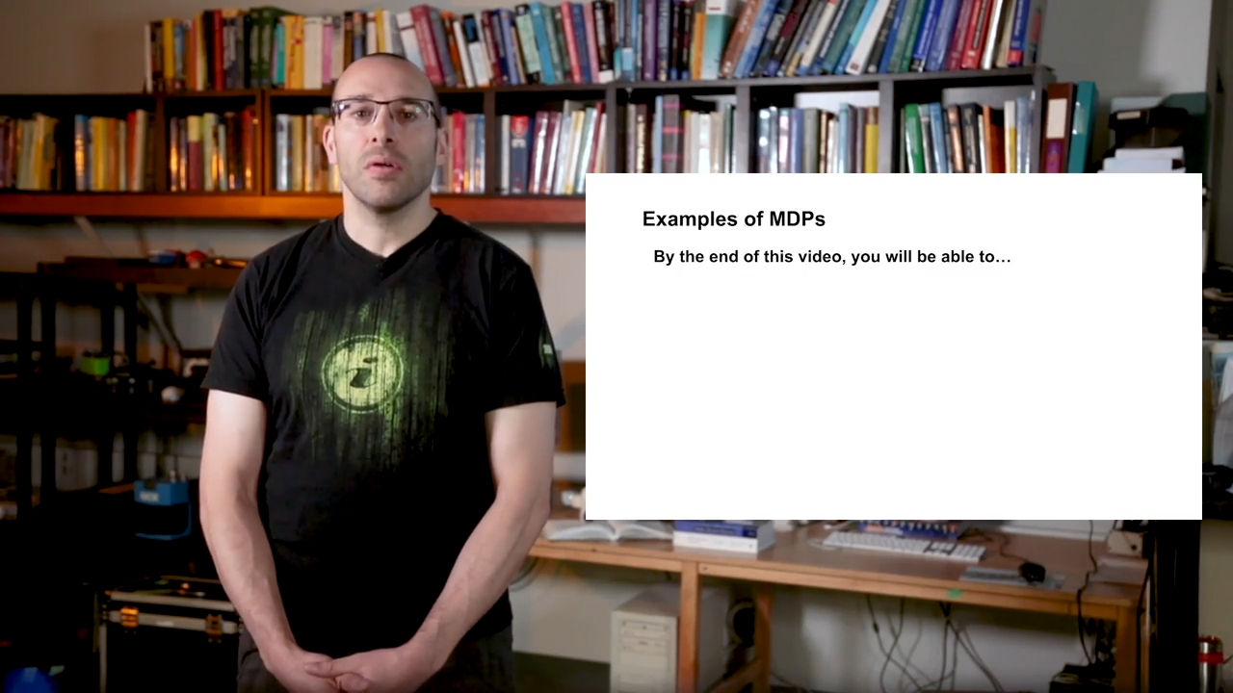
Title

Slide 5
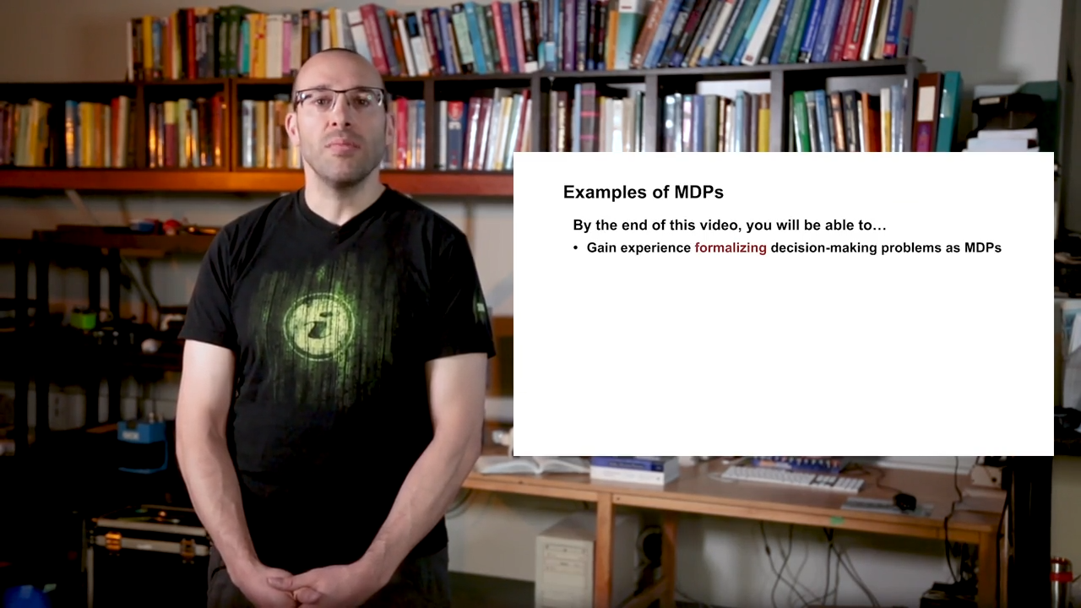
Title

Slide 6

Title

Slide 7
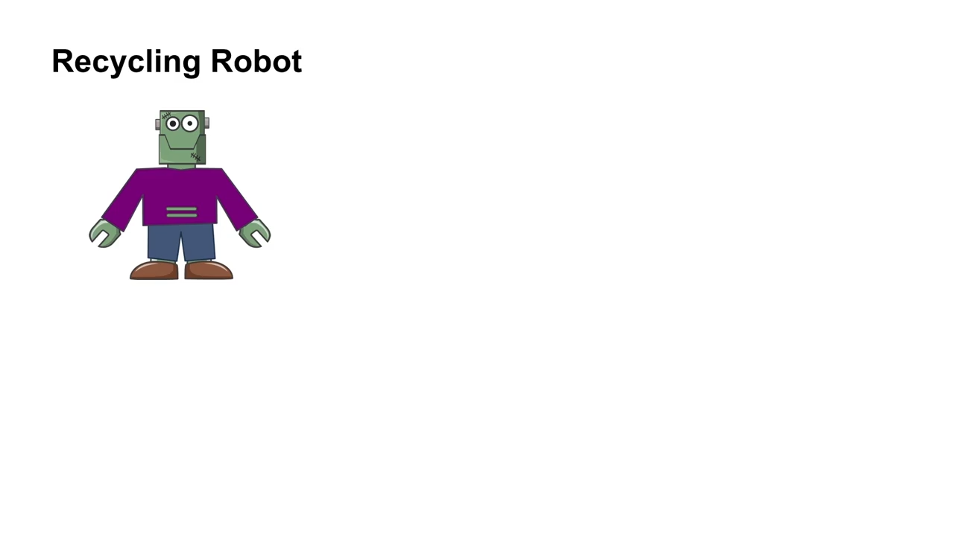
Title

Slide 8
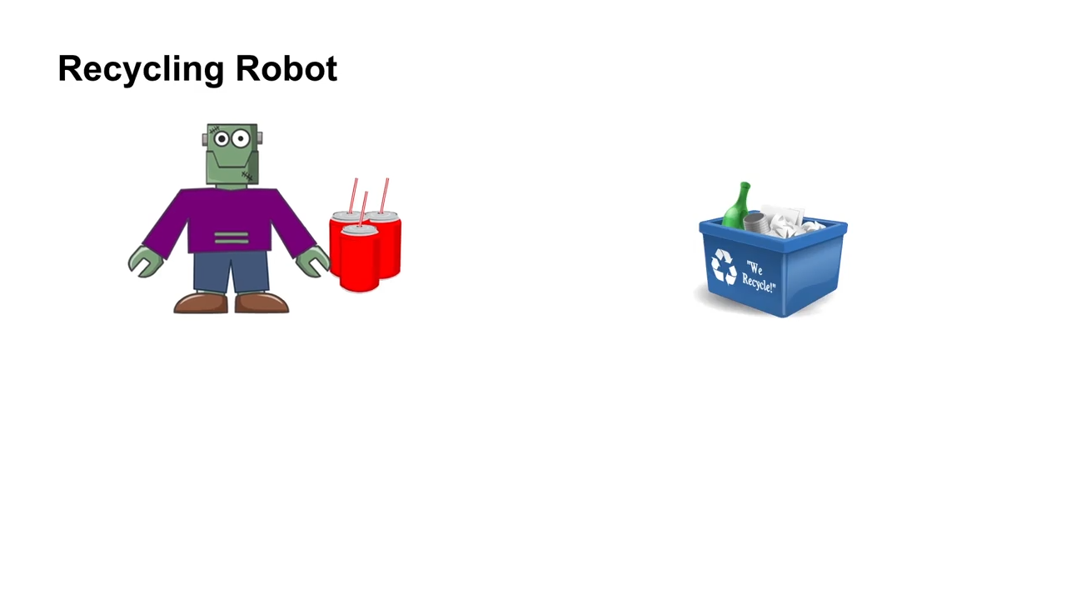
Title

Slide 9
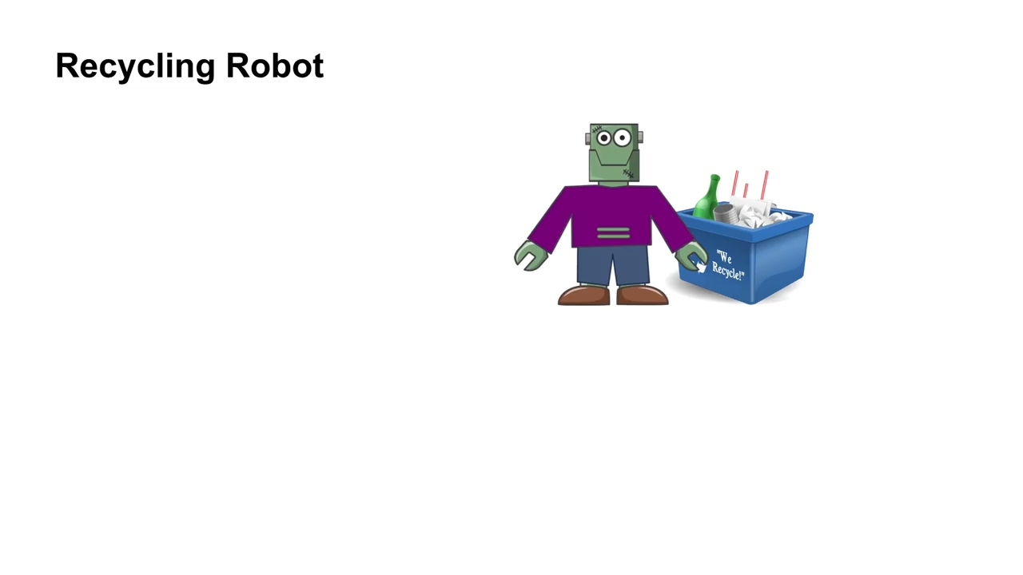
Title

Slide 10
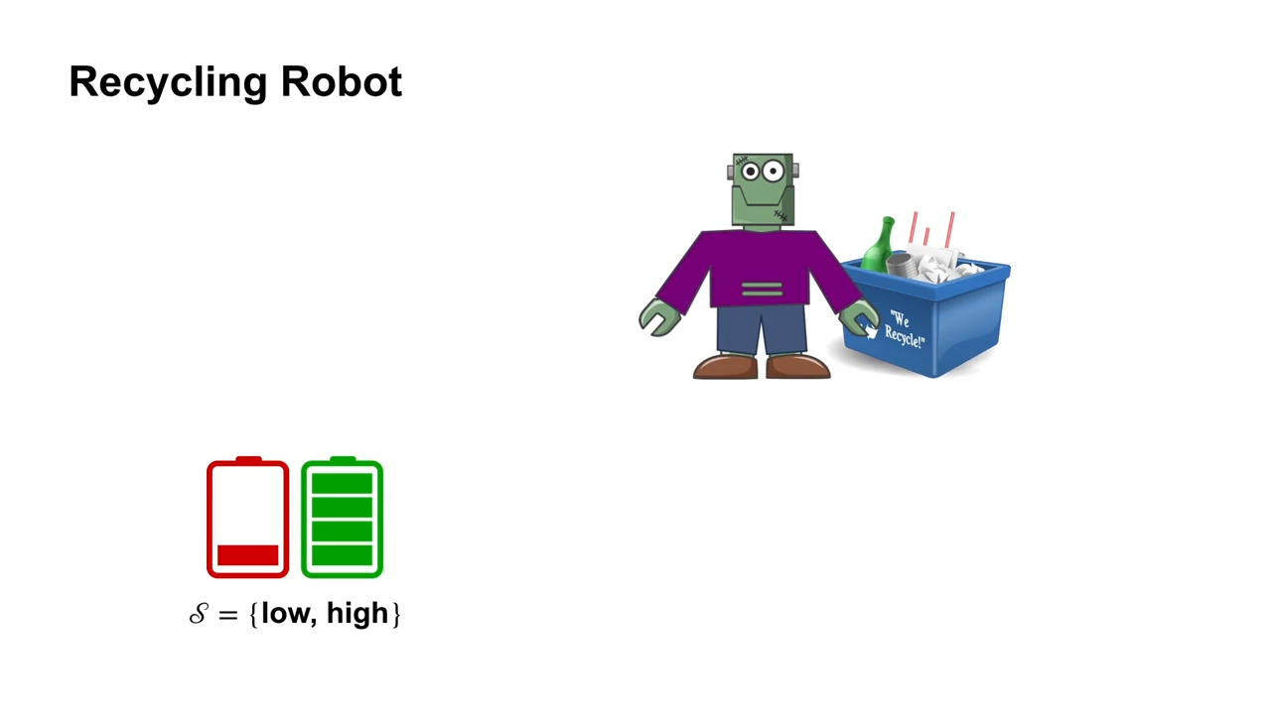
Title

Slide 11
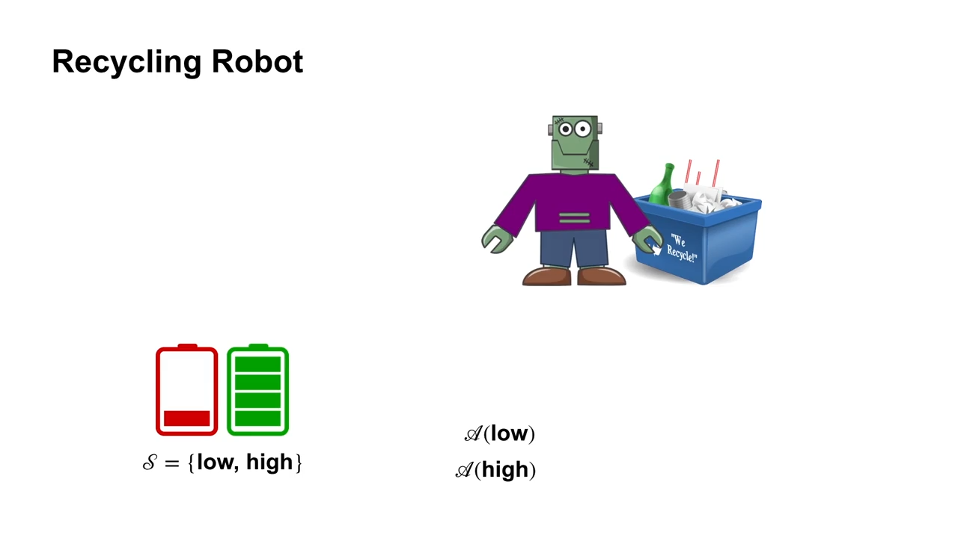
Title

Slide 12
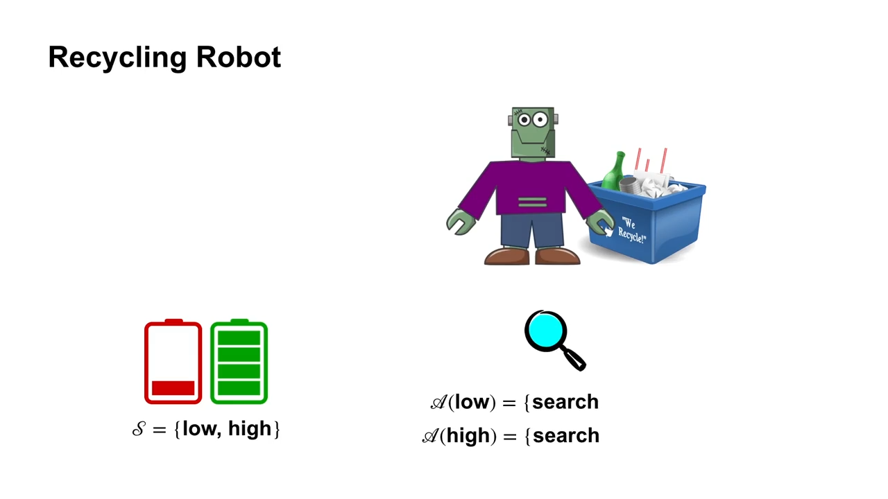
Title

Slide 13
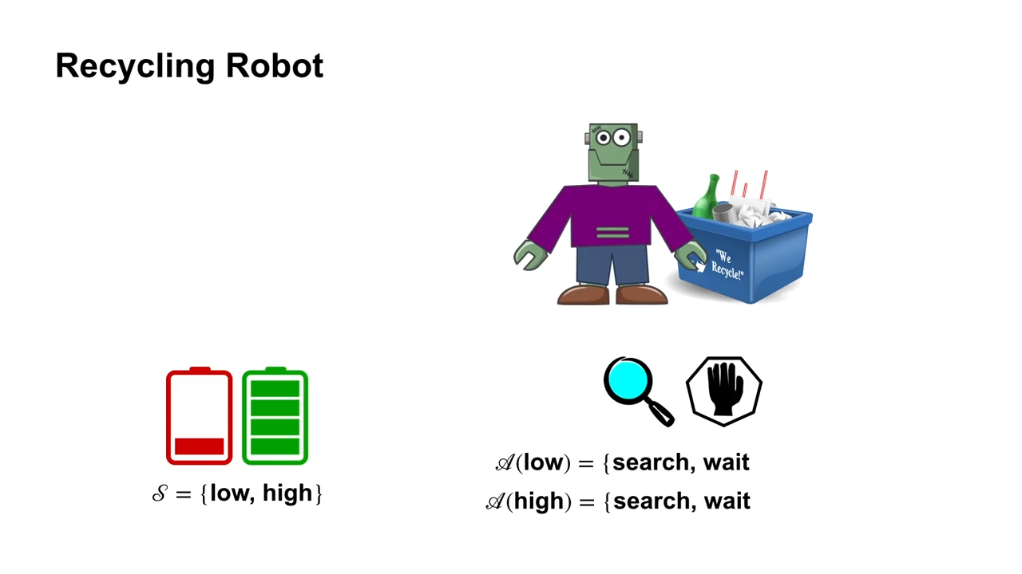
Title

Slide 14
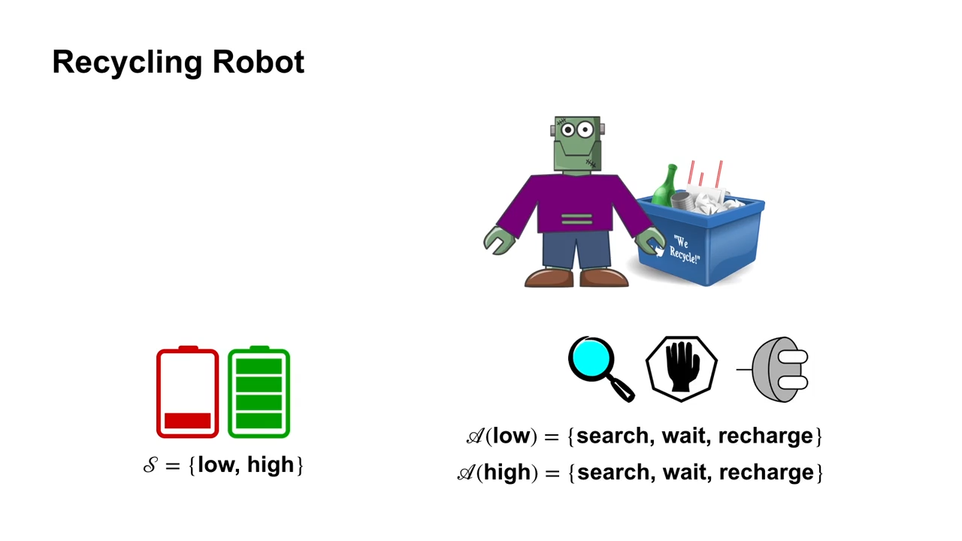
Title

Slide 15

Title

Slide 16
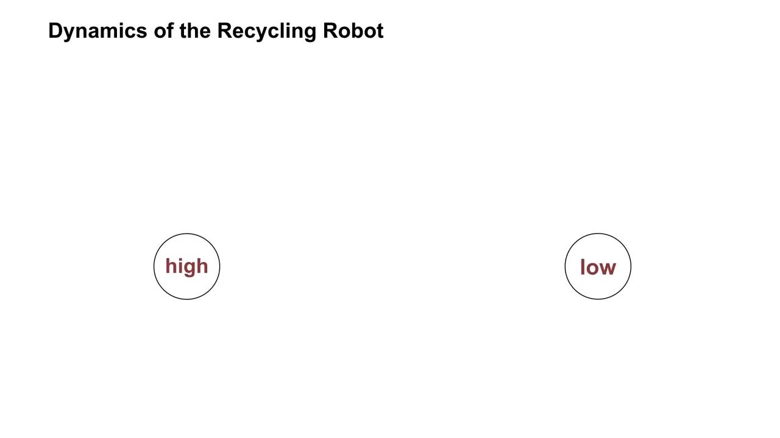
Title

Slide 17
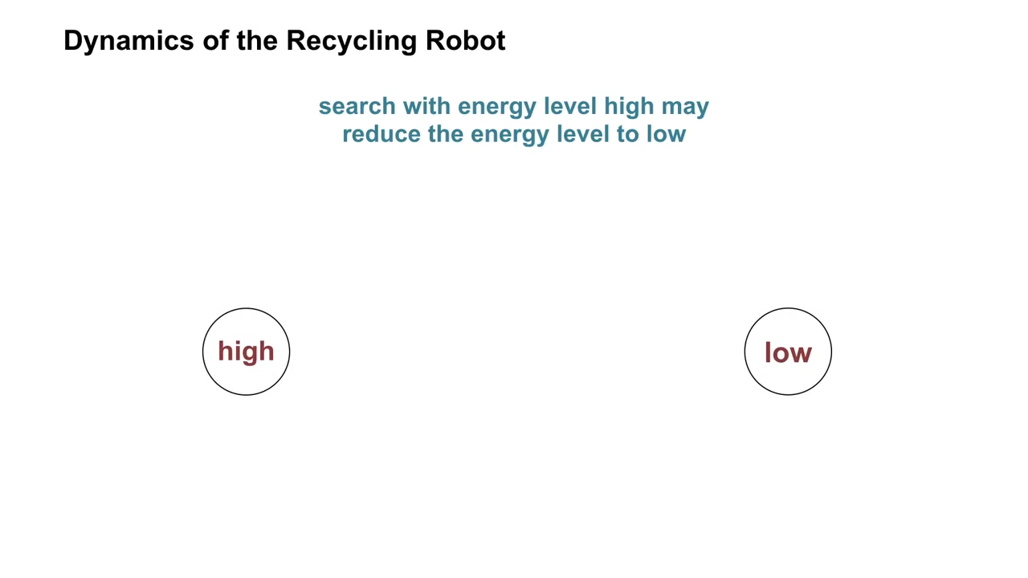
Title

Slide 18
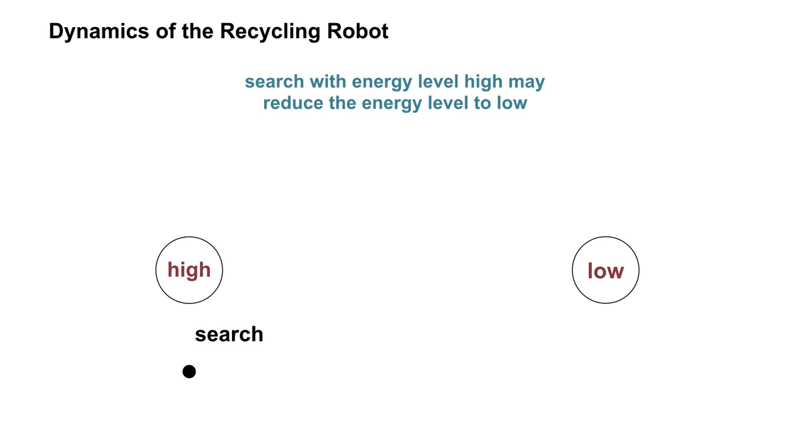
Title

Slide 19
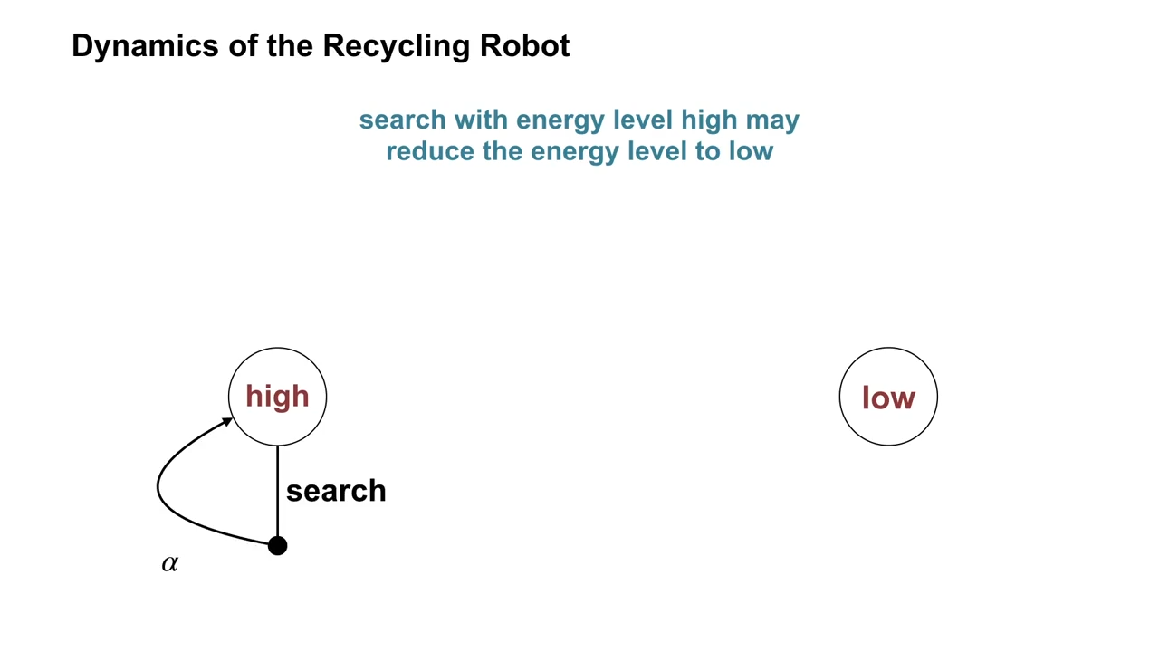
Title

Slide 20
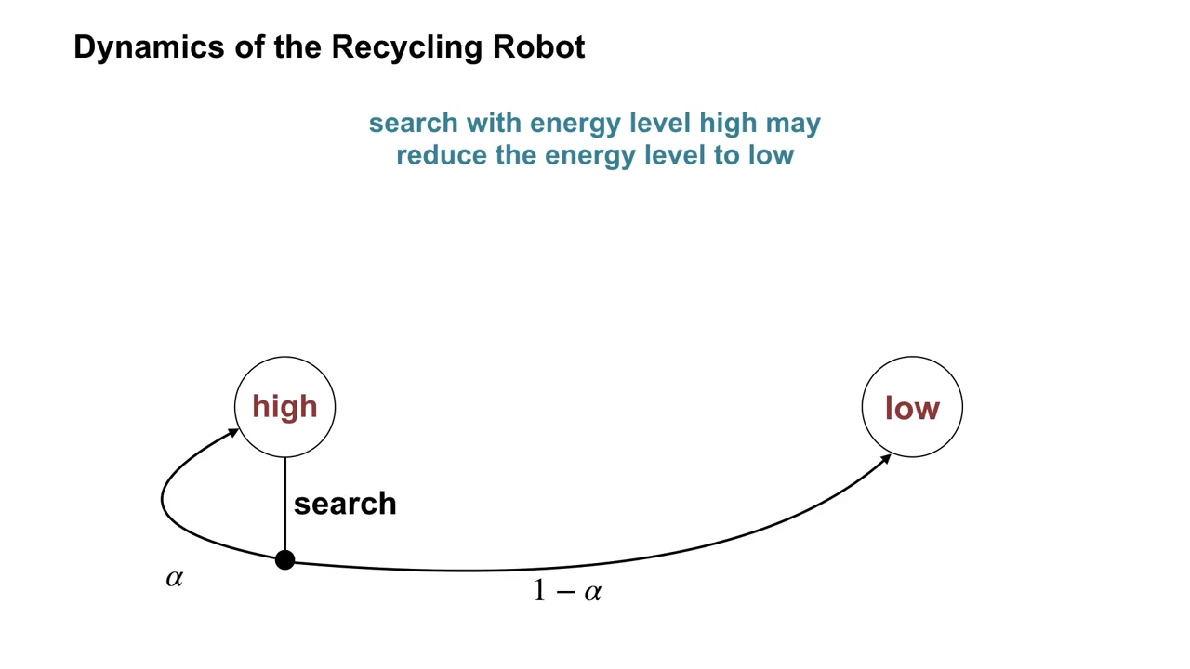
Title

Slide 21
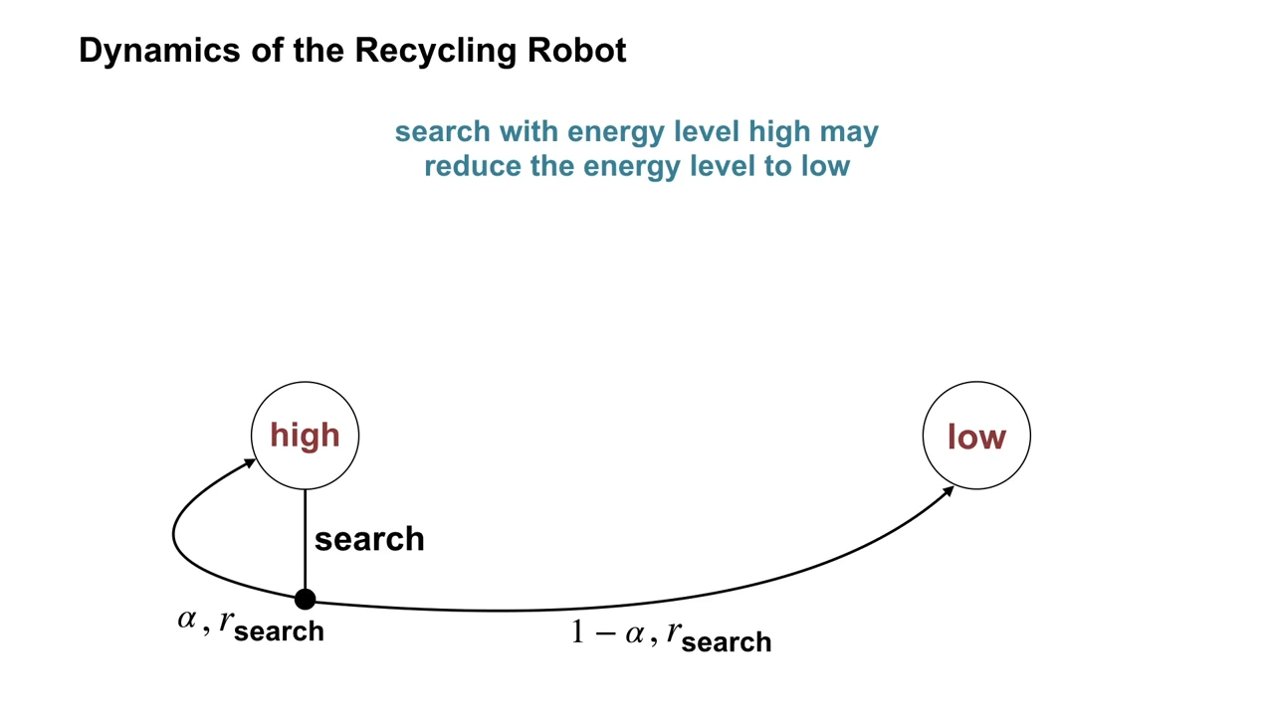
Title

Slide 22
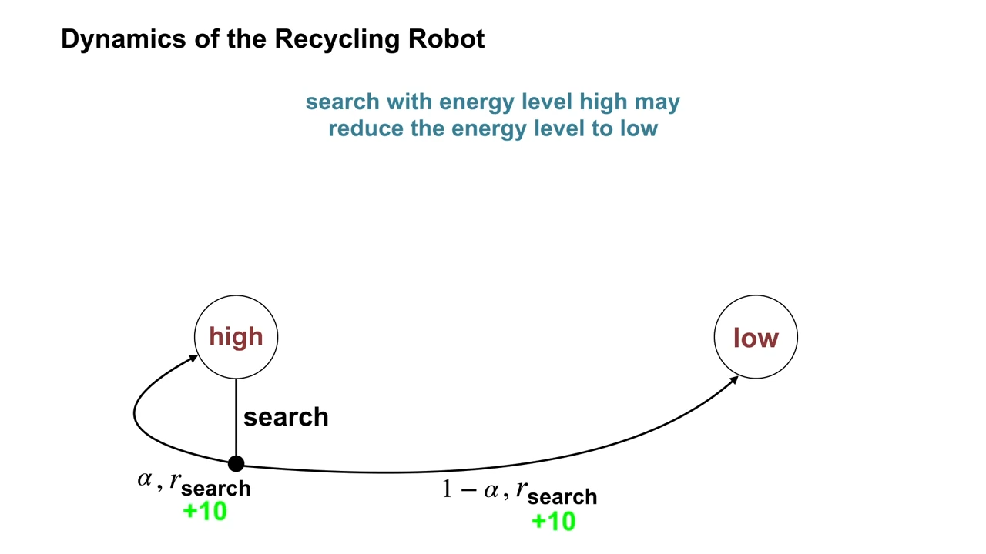
Title

Slide 23
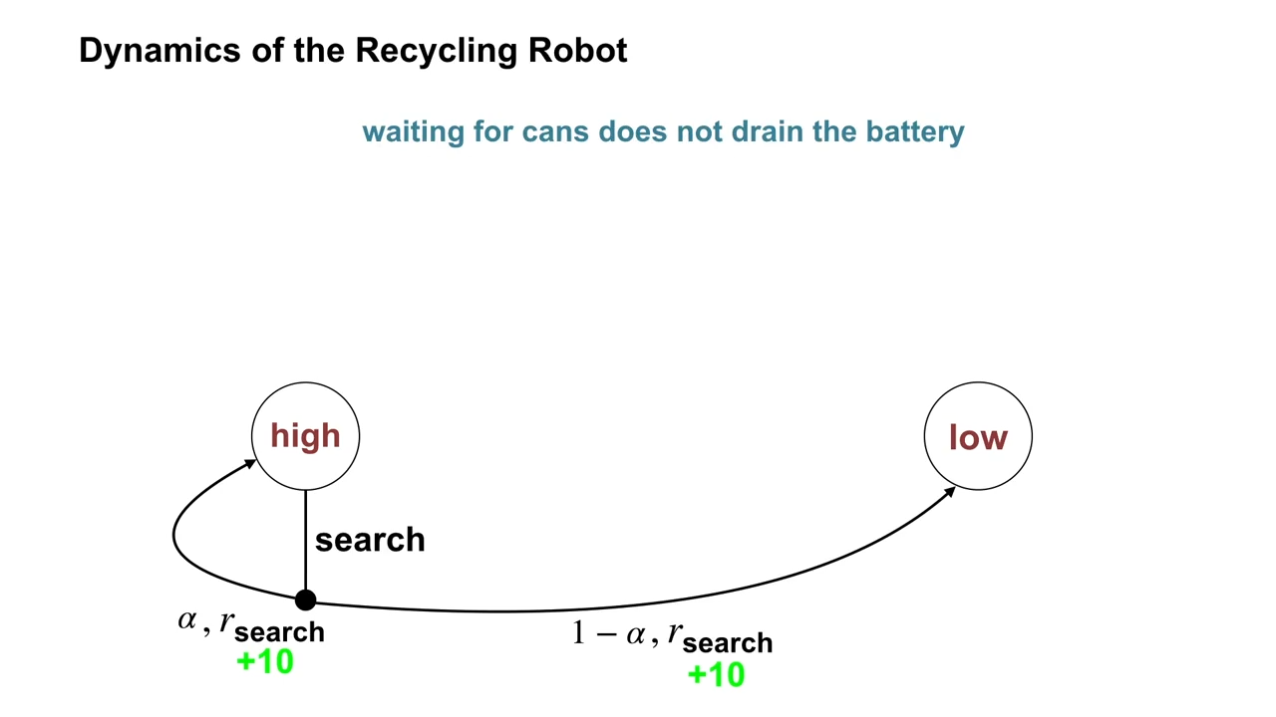
Title

Slide 24
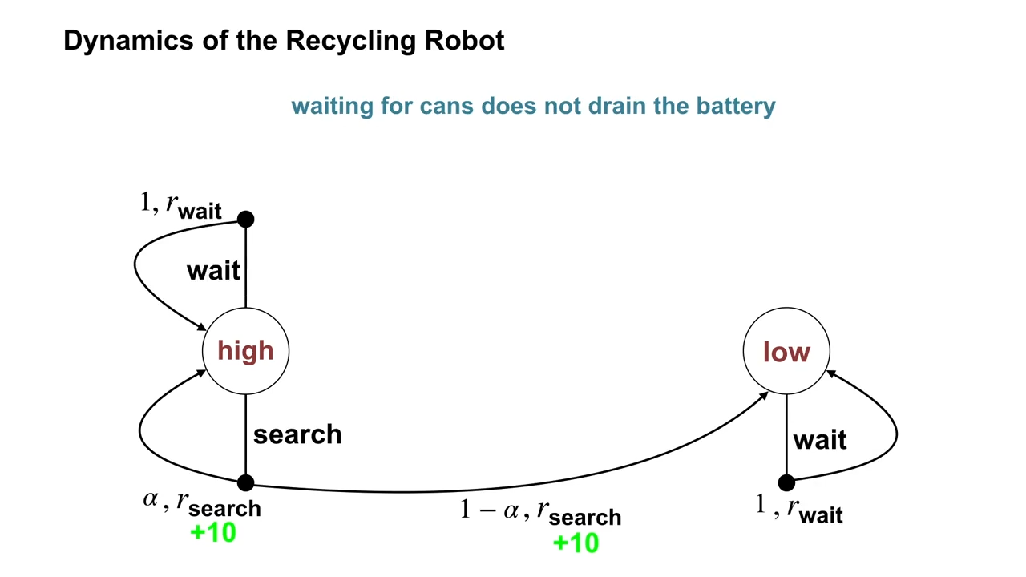
Title

Slide 25
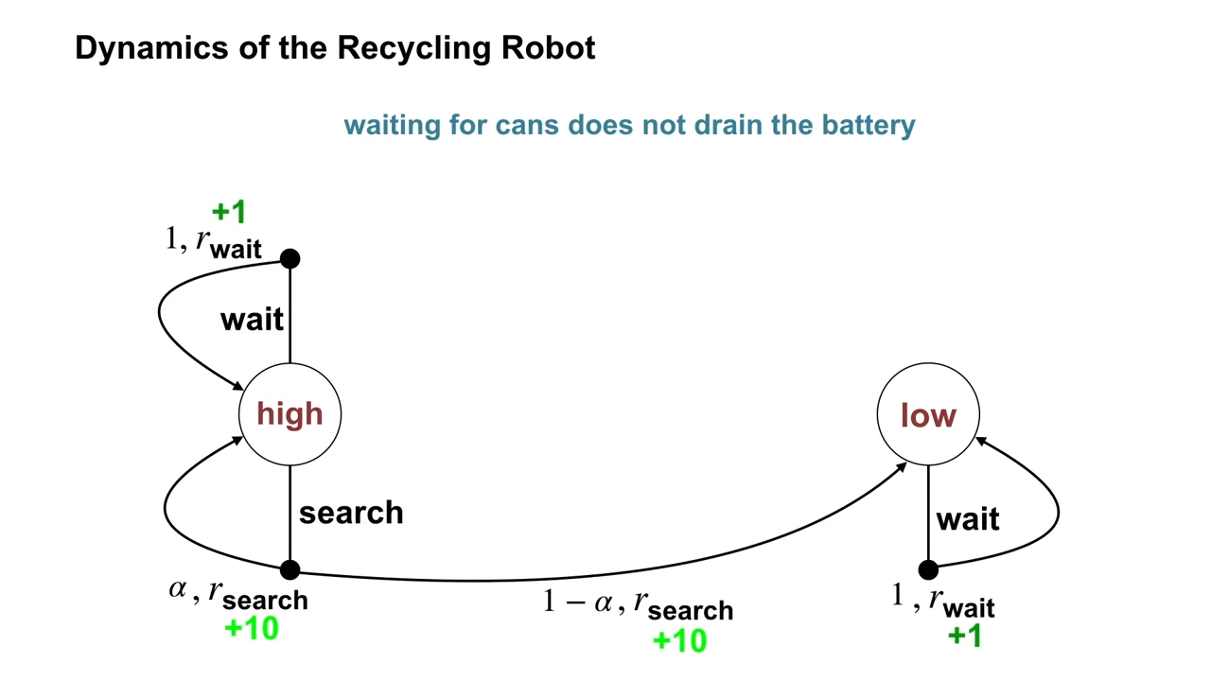
Title

Slide 26
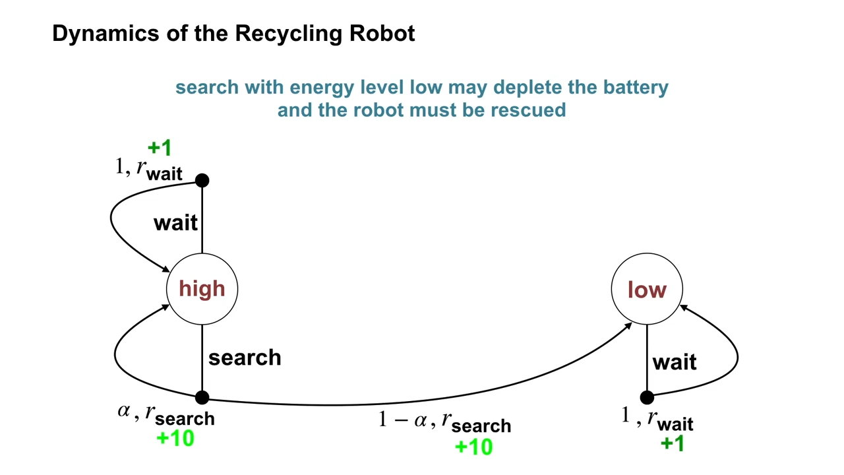
Title

Slide 27
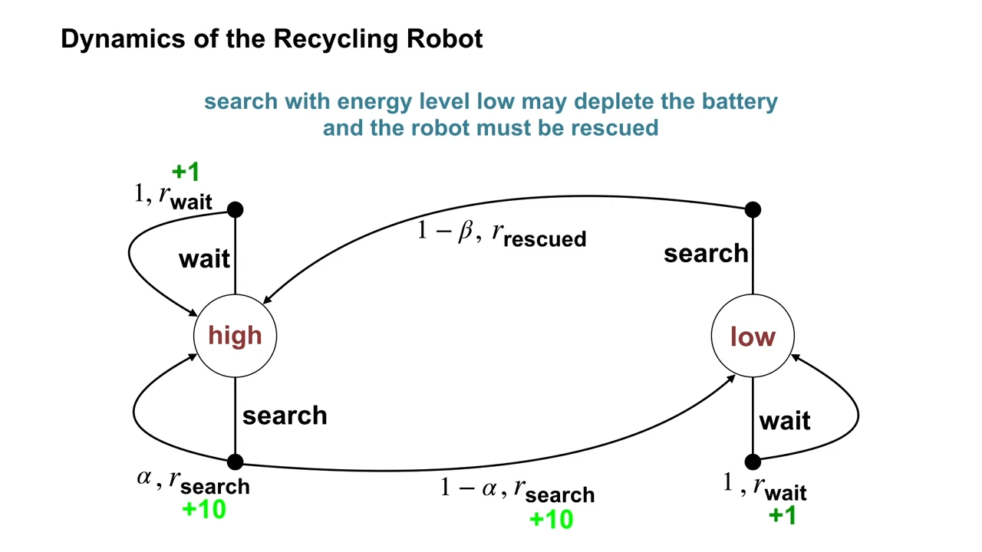
Title

Slide 28
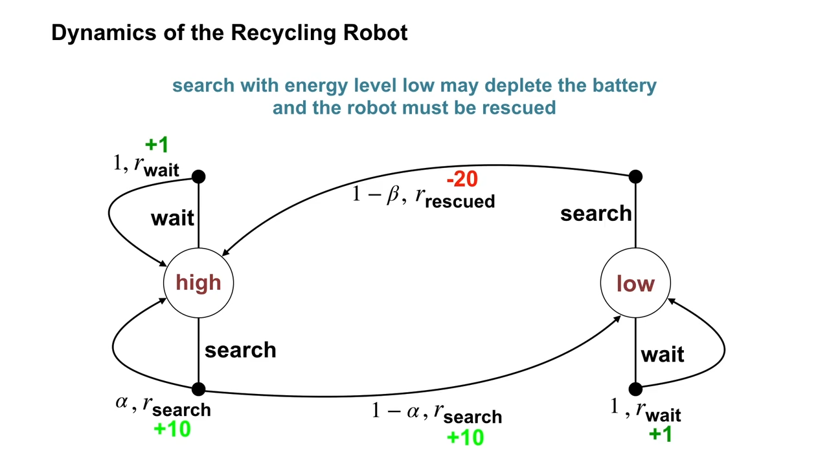
Title

Slide 29
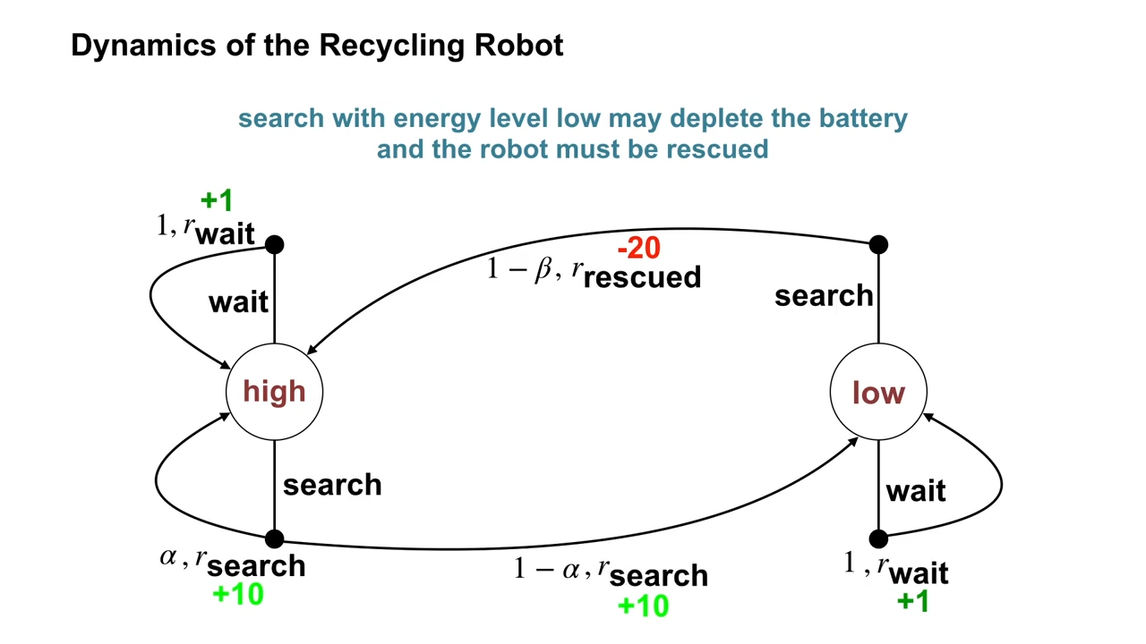
Title

Slide 30
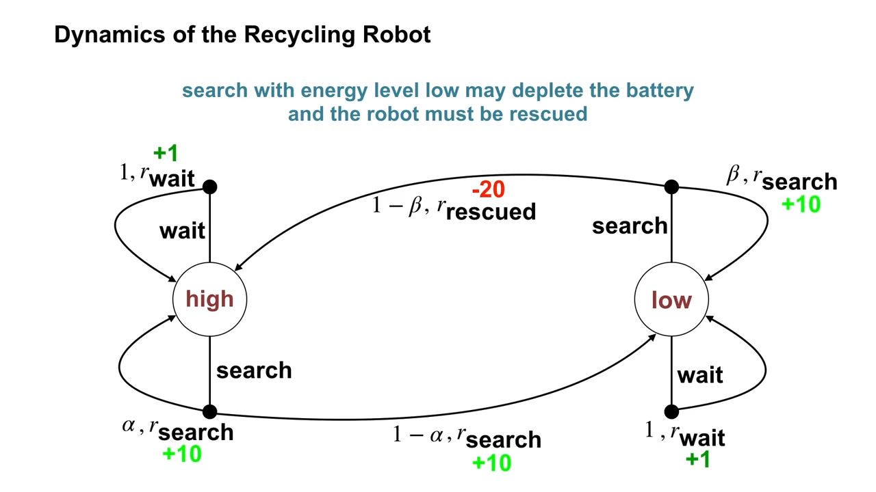
Title

Slide 31
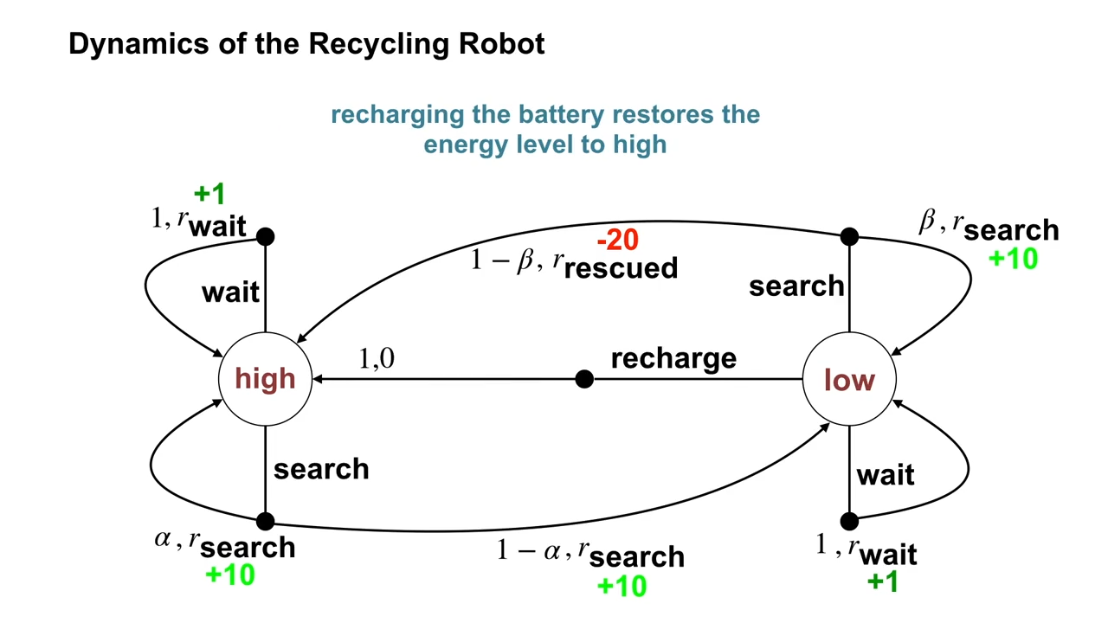
Title

Slide 32
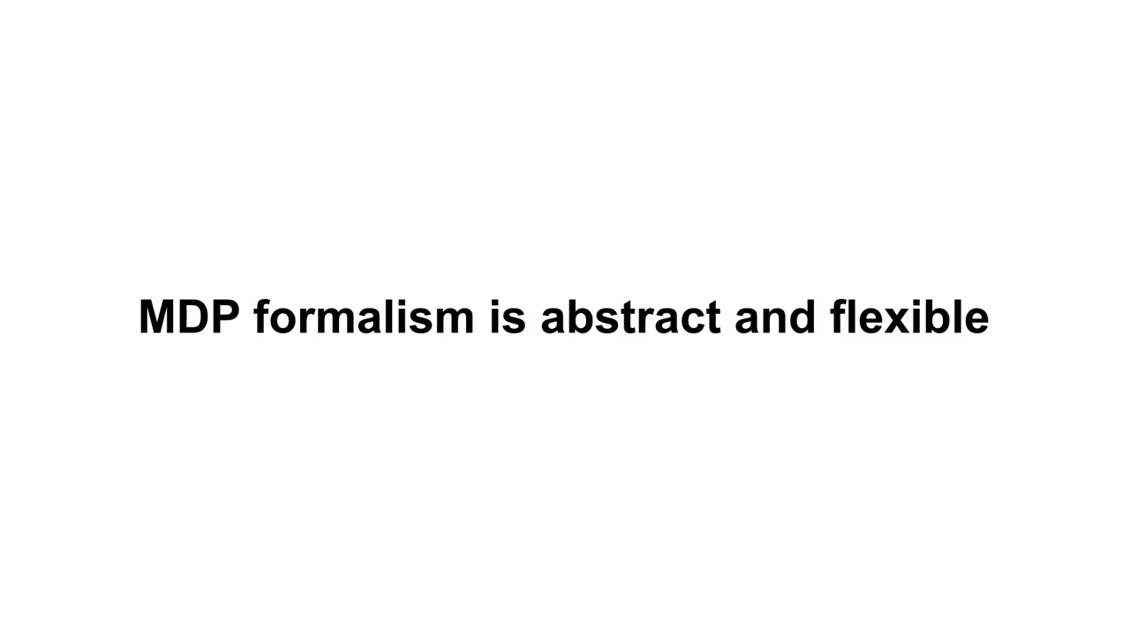
Title

Slide 33
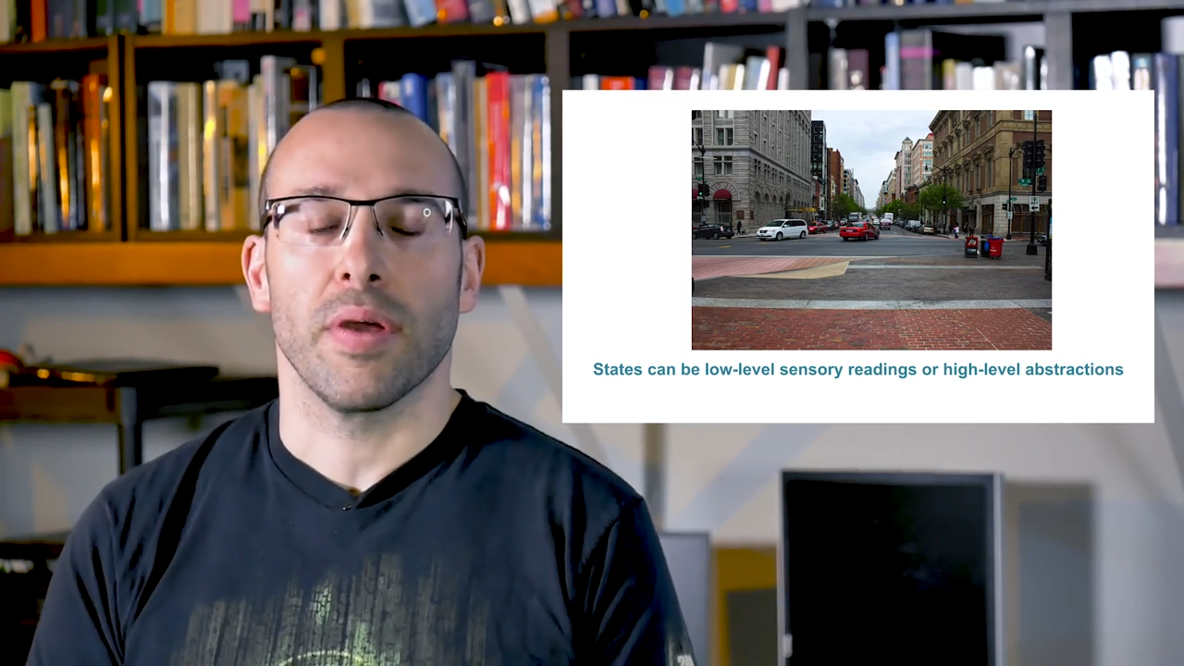
Title

Slide 34
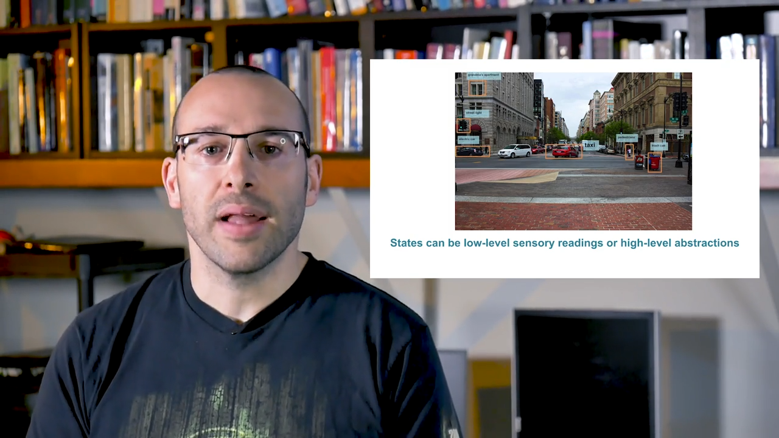
Title

Slide 35
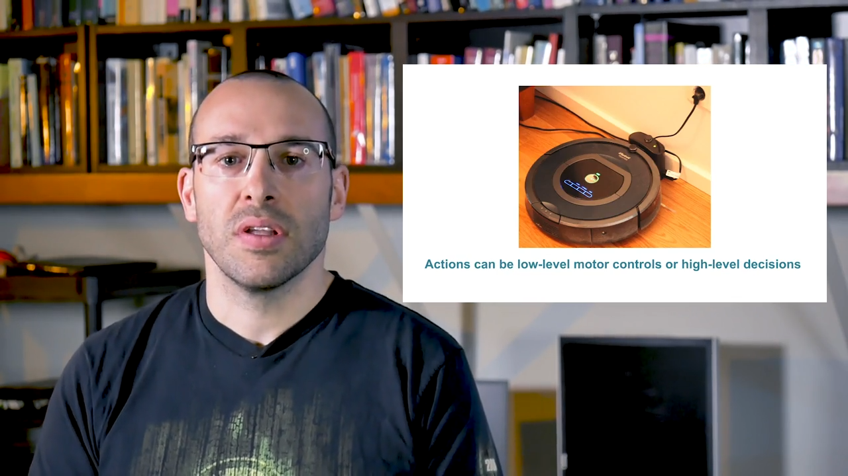
Title

Slide 36
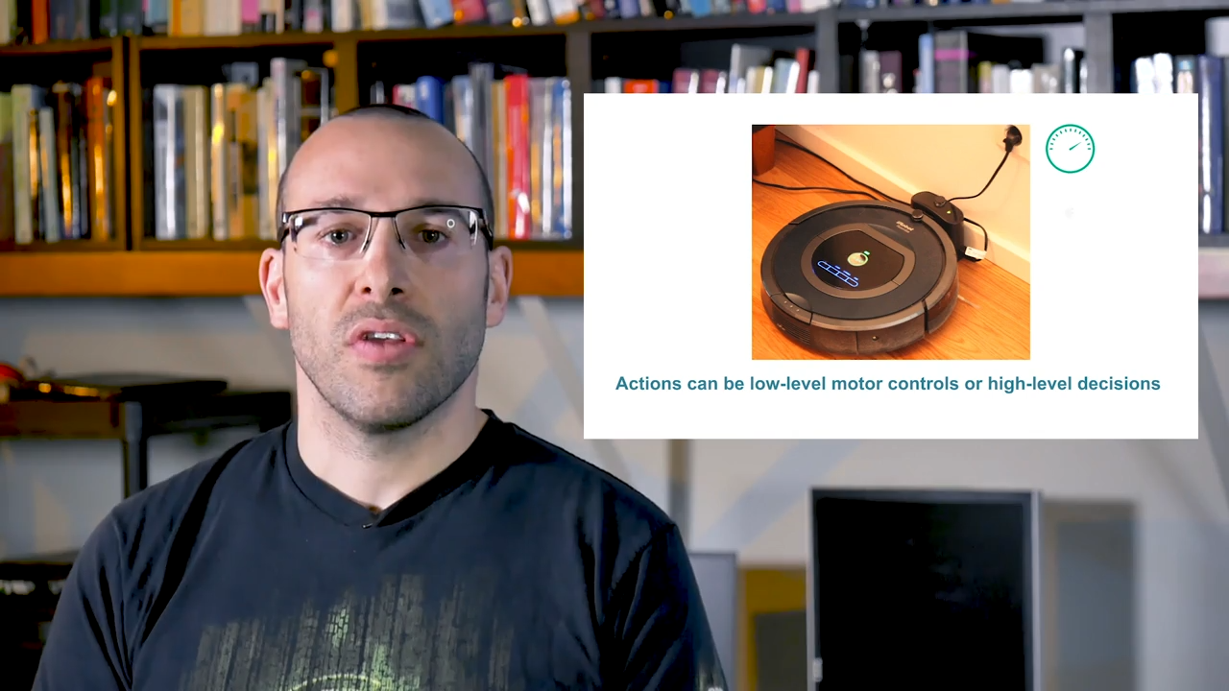
Title

Slide 37
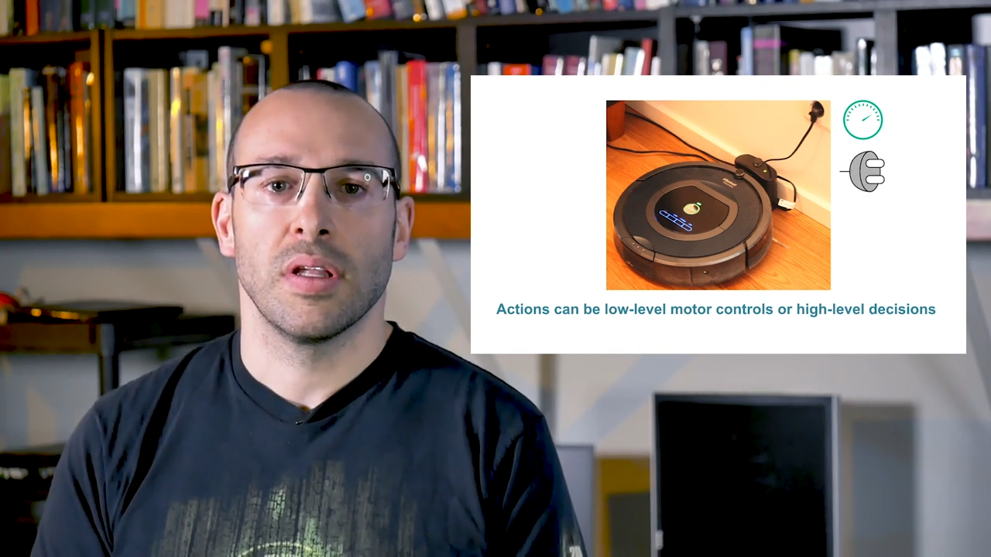
Title

Slide 38
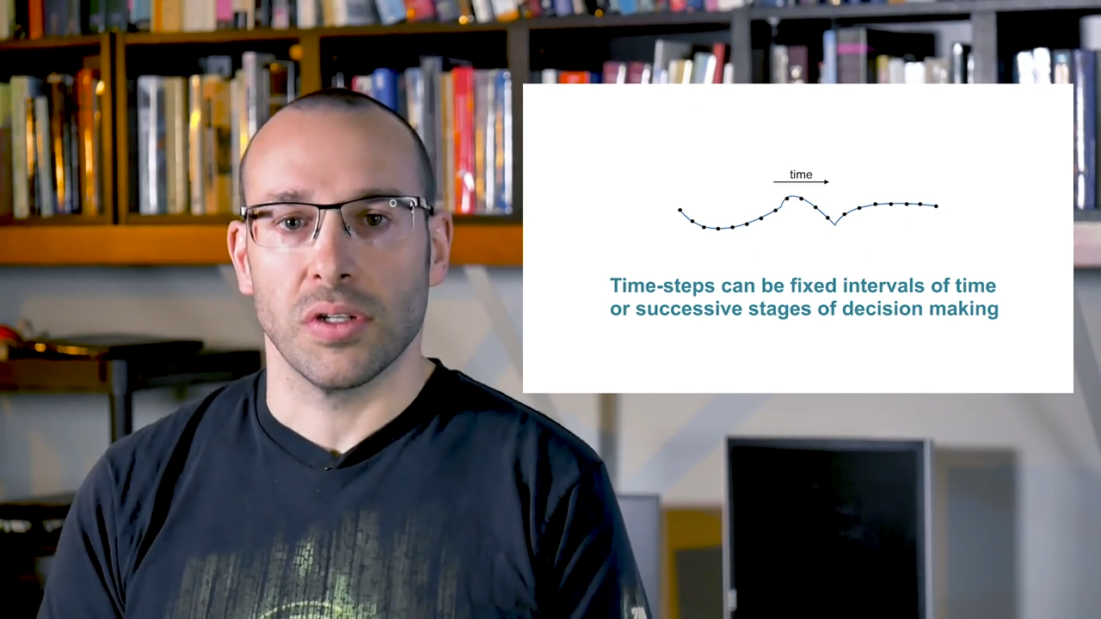
Title

Slide 39
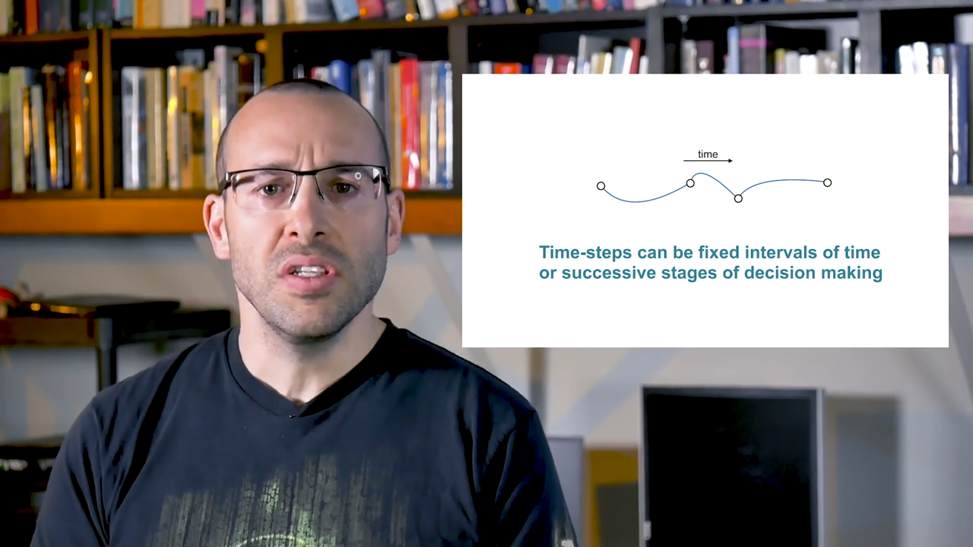
Title

Slide 40
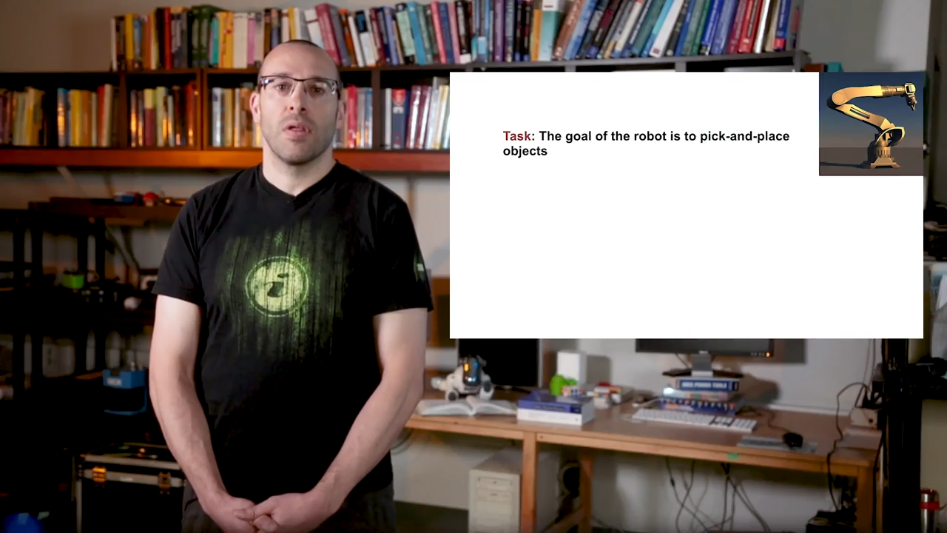
Title

Slide 41

Title

Slide 42

Title

Slide 43

Title

Slide 44
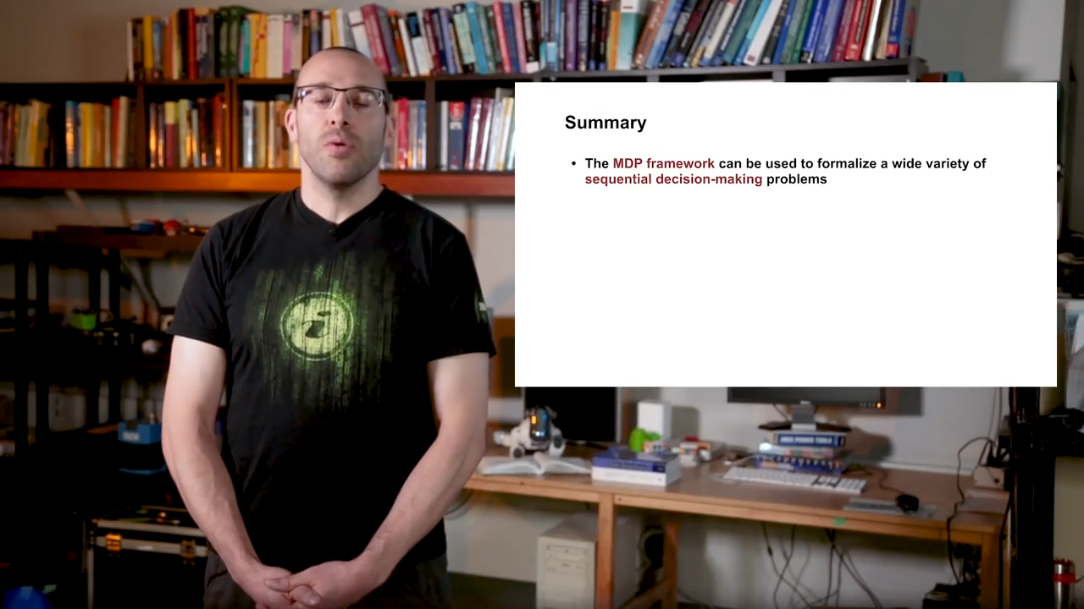
Title

Slide 45
Title

Slide 46
Title

Slide 47
Title

Slide 48
Title

Slide 49
Title

Slide 50
Title

Slide 51
Title

Slide 52
Title

Slide 53
Title

Slide 54
Title

Slide 55
Title

Slide 56
Title

Slide 57
Title

Slide 58
Title

Slide 59
Title

Slide 60
Title

Slide 61
Title

Slide 62
Title

Slide 63
Title

Slide 64
Title

Slide 65
Title

Slide 66
Title

Slide 67
Title

Slide 68
Title

Slide 69
Title

Slide 70
Title

Slide 71
Title

Slide 72
Title

Slide 73
Title

Slide 74
Title
Title
Notes:
Reason for splitting dataset while the author use ICL?

Slide 75
Title

Slide 76
THANK YOU !

